Slide 1
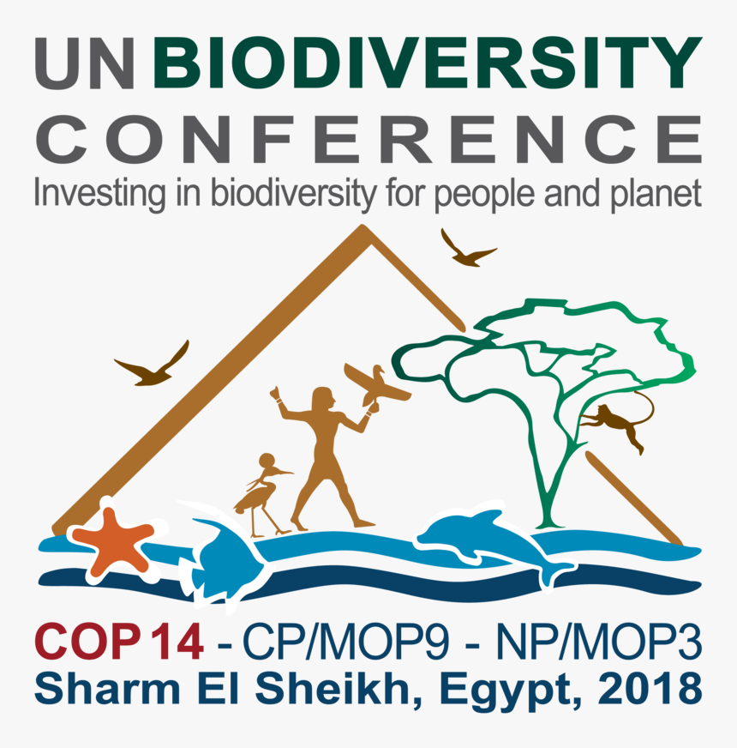
Ms. J. Catalina Santamaria
Secretariat of the Convention on Biological Diversity
Webinar on Biosafety Commitments for the Action Agenda for Nature and People
27 September 2021 (10:30 am EST)
Notes:
(Welcoming statement.)
On behalf of the SCBD, let me express our deep thanks to all the participants joining today ( over 200) and to the many non state actors engaged in the Biosafety protocol and the CBD process, who have already made voluntary commitments in support of the post 2020 framework, through the Sharm El Sheikh to Kunming Action Agenda for Nature and People.
We applaud your support and active work through the Action Agenda to inspire and join the global response to reverse biodiversity loss.
Your commitments have spark important feedback loops to catalyze further ambition in response to the urgent call to action for biodiversity in this decisive decade of transformation.
Turning to my presentation, let me share brief highlights on : 1/ Context of the AA ; 2/ its scope of work and structure; 3/ explain the notion of commitments and type of engagement; 4/ share the 11 action categories; and 5/ explain the steps to making a commitment.

Slide 2
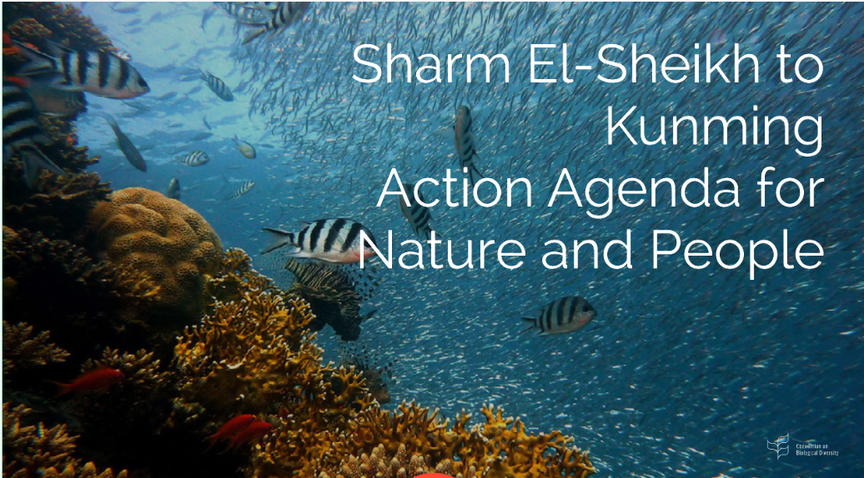
What is the Sharm El-Sheikh to Kunming Action Agenda?
1.Context & Purpose
Connect actions to the - post 2020 Global Biodiversity Framework;
- Implementation Plan for the Biosafety Protocol
-Capacity-building Action Plan for the Protocol
Spearheaded at COP14 (2018) by the Governments of Egypt and China;
Mechanism to raise public and policy awareness, inspire sub-national and non-state actor commitments and catalyze upward cycles of ambition to 2030 and beyond;
Supports a whole of society approach to join the global response to biodiversity;
Proves that sub-national and non-state actors can complement the policy process with meaningful actions and active engagement to support governments;
Ultimately it aims to generate a measurable impact and shift in the management of stakeholder’s own activities to reverse loss, reduce risks and recover biodiversity.
Why is it so important?
(1) showcases key actions to reverse biodiversity loss, in each big impact areas;
(2) demonstrates, through individual & cooperative commitments, the actors already committed to the necessary transition to achieve the 2030 goals & targets; (3) raises public awareness of the risks of biodiversity loss for people & the economy; (4) encourages others to take action because it is in their best interest; (5) helps organize, explain actions and examine target setting within economic sectors; (6) catalyzes cooperative initiatives across sectors and stakeholders; (7) supports implementation at the global, domestic and local levels;
(8) connects networks, builds capacities and promotes knowledge exchange and the development of guidance, to offer new solutions to reach our shared goals.
Notes:
As per COP decision 14/34 the overall objective of the AA is to invite, prior to the fifteenth meeting of the Conference of the Parties, voluntary biodiversity commitments, from indigenous peoples and local communities, women, youth, civil society, local governments and authorities, academia, the business and financial sectors and other relevant stakeholders, to provide momentum for the ambition and contribute to the implementation of a post-2020 global biodiversity framework.

Slide 3
2. Structure of the
Action Agenda
Contributions to 15th Conference of the Parties (COP15), the 10th Conference of the Parties serving as the meeting of the Parties (COP-MOP 10) and beyond
Impact/Incentive:
2021 Critical year – guiding actions in this decisive decade for nature and people
Action Agenda pillars of work:
Short to medium term expectations:
2020-2021 Developments:
Policy Process- COP14 & 15 Presidencies
Stakeholder
Engagement – motivation and opportunities
Outreach & Advocacy – Campaigns, Media and Profiling
Analyses & IT platform
Continued political support from COP Presidencies.
Recognition of Action Agenda in COP decisions.
Growth in collective actions across sectors.
Stakeholders examine, discuss and set SMART commitments.
Campaigns/ Partnerships
Dialogues show meaningful engagement / contributions to post 2020 process
Greater platform interoperability.
Clear methodology to track progress
Discussions on-going under Subsidiary Body on Implementation – decision on the Action Agenda
More Non State Actor representatives are getting involved
Webinars; Videos; Media materials; Informal Friends of Action Group - narrative, identifying sectors; planning reports and events.
213 commitments registered; 99 partnerships initiatives; link to host country webpage
Notes:
Policy: Discussions on-going under CBD subsidiary bodies – links to monitoring; cooperation; mainstreaming; communications
Engagement: More representatives are getting involved (Business alliances are active – taking steps to sign common commitments; prepare smart commitments; and engage external stakeholders).
Outreach: Webinars; Videos; Media materials; Informal Friends of Action Group - joint narrative, identifying sectors; planning reports and events.
Commitments: over 201 pledges + over 300 stakeholders involved in 44 submissions by coalitions and alliances and at least 34 submissions including sub-commitments. More expected in run up to COP15.

Slide 4
What are non state actors? Who is involved in the Action Agenda?
Civil Society groups – NGOs, foundations, women’s groups
Academia & research institutes
Private Sector and Business
Sub-national and local governments and authorities
Youth groups
Indigenous peoples and local communities (IPLCs)
Farmer’s orgnizations
UN system / IGO agencies
Individuals
3. Actors and Commitments
Criteria:
https://www.cbd.int/action-agenda/criteria.shtml
What is a voluntary commitment?
A pledge to take action to improve the state of biodiversity, through different approaches and measures, based on science, inspiring others and aligned to one or more of the CBD objectives.
Applies to any scale, level & sector. Submitted by non state actors.
Includes relevant, tangible and measurable actions.
Contributes to the transformational changes needed to put biodiversity on a path to recovery by 2030.
Contributes to other SDGs to enhance integrated solutions.
Indicates how results will be reported, including baselines and metrics that will be used in the process.
Notes:
Background:
Applies to any scale and level and submitted by any sectors & stakeholders Commitments can include large scale actions like restoring degraded ecosystems or setting aside protected areas to individual actions such as planting pollen and nectar plants. They could also contain targeted measures addressing direct or indirect causes of biodiversity loss, or the achievement of measurable conservation and sustainable use objectives.
Commitments should contribute to long term sustainable development.
Commitments could build upon existing cross sectoral initiatives, such as those to achieve the Sustainable Development Goals, the objectives of the Paris Agreement and the land degradation neutrality goal under the UN Convention to Combat Desertification, among others.
Actions to implement the commitments could depict ways and means to support the mainstreaming of biodiversity considerations across productive sectors addressed at COP13 and COP14.
Actions to implement the commitments could envisage how to include value chains in their ambition, whenever possible, as this is the most concrete way of scaling up success and fundamentally engaging small and medium companies in the long run.
ABT serve as a guide while new framework is adopted.

Slide 5
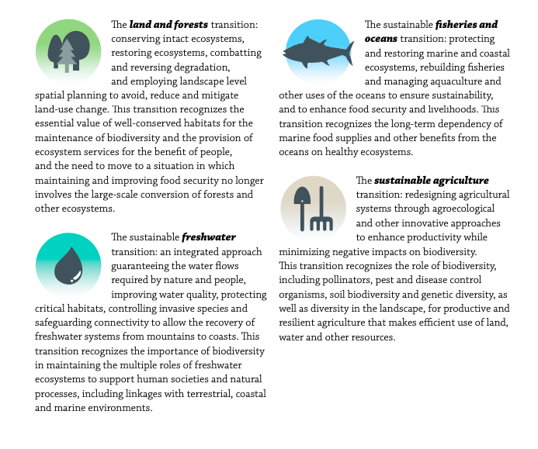
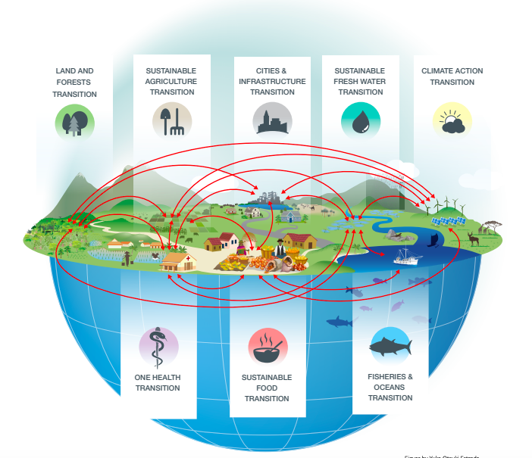
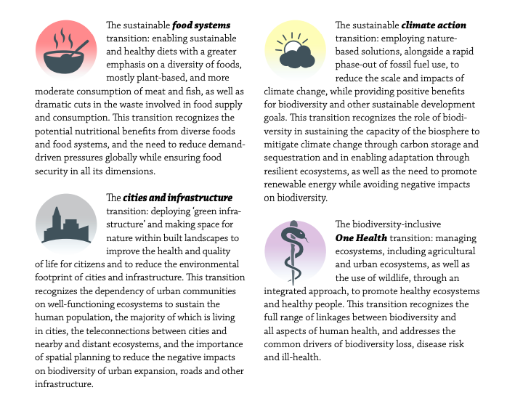
GBO 5
Notes:
Drawing on the science, the 5th edition of the Global Biodiversity Outlook, noted that ultimately reaching the 2050 Vision for Biodiversity will require a set of transitions in particular sectors and areas of human activity. They identified eight distinct but closely inter-related aspects of the interface between people and nature:
Background:
[the use of land, forests and other ecosystems;
the management of freshwater ecosystems;
marine fisheries and other uses of the ocean;
the production of agricultural products from the landscape; the food system, including diets,
demand, supply chains and waste;
the footprint and requirements of cities and infrastructure;
the interaction between ecosystems and climate change; and the multi-faceted connections between nature and human health.]

Slide 6
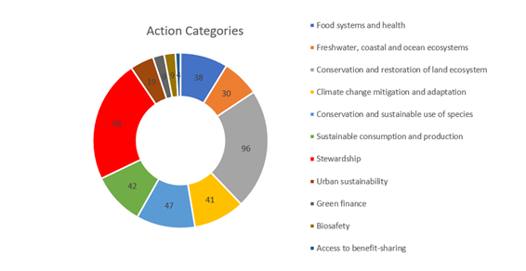
4. Action Categories:
1.food systems & health;
2. freshwater, coastal & ocean ecosystems;
3. conservation & restoration of land ecosystem;
4. climate change mitigation & adaptation;
5. conservation & sustainable use of species;
6. sustainable consumption & production;
7. stewardship;
8. urban sustainability;
9. green finance;
10. biosafety;
11. access to benefit-sharing mechanisms.
Notes:
The GBO5 analysis helped to identified the 11 Action categories of the Action Agenda, with the addition of finance, biosafety and ABS.
As you can see - highest commitments in the conservation and restoration of land ecosystems and stewardship of biodiversity.
Commitments have been seen to cover a single category, as well as multiple action categories (seen in the context of stewardship).
7 Commitments on biosafety have been received. And we will hear reflections from participants on their commitments and actions and count on more organizations and coalitions groups to submit their commitments and join the Action Agenda to champion the global response for biodiversity in the lead up to COP15.

Slide 7
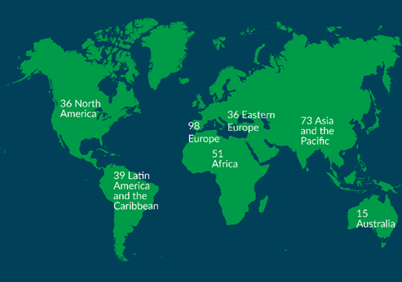
5. Steps to make your voluntary commitment
Impact/Incentive:
How to make a commitment?
1. Make your assessment and define the scale of your actions. What need to change and why? Where are improvements needed and how can your commitment improve the state of biodiversity? Where and how can your organization make the most positive change, internally and externally?
2. Plan, prioritise, examine the trade-offs, and your budget and tracking methods. Identify what, how and with whom you can implement and monitor your actions. Recognize how your commitment can generate a measurable impact and shift in the management of your own activities.
3. Identify and review the Action Agenda form that best fits your organization.
4. Check the criteria, fill the form and submit your commitment.
5. Lead by example and connect with the Secretariat to promote your commitment!

Slide 8
5. Steps to make your voluntary commitment
Impact/Incentive:
How to make a commitment?

Slide 9
5. Steps to find a pledge
Impact/Incentive:
How to find a commitment?

Slide 10
Biosafety Commitments in the Action Agenda

Slide 11
Join the global movement: https://www.cbd.int/portals/action-agenda/

Slide 12
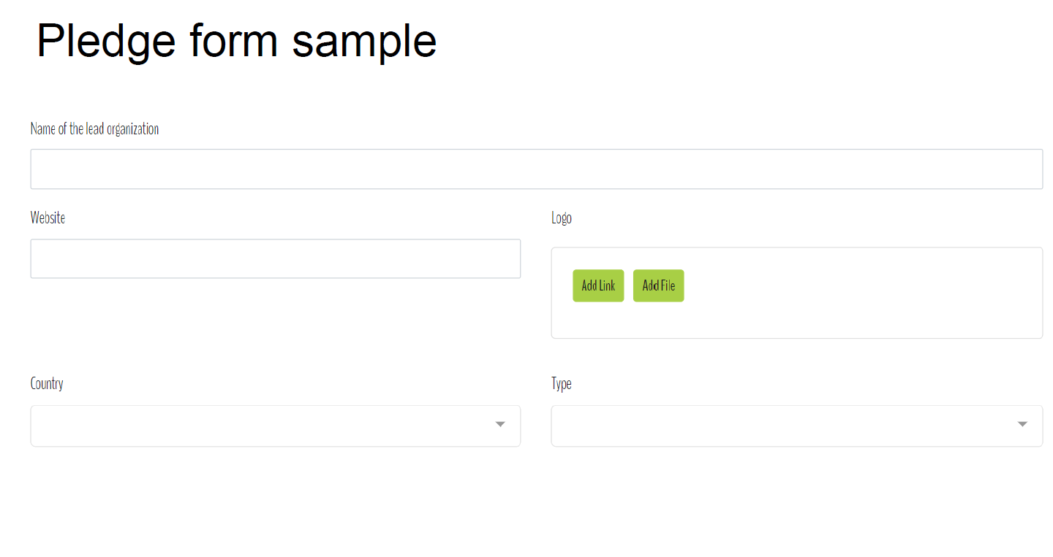
5. Steps to make your voluntary commitment
Impact/Incentive:
How to make a commitment?

Slide 13
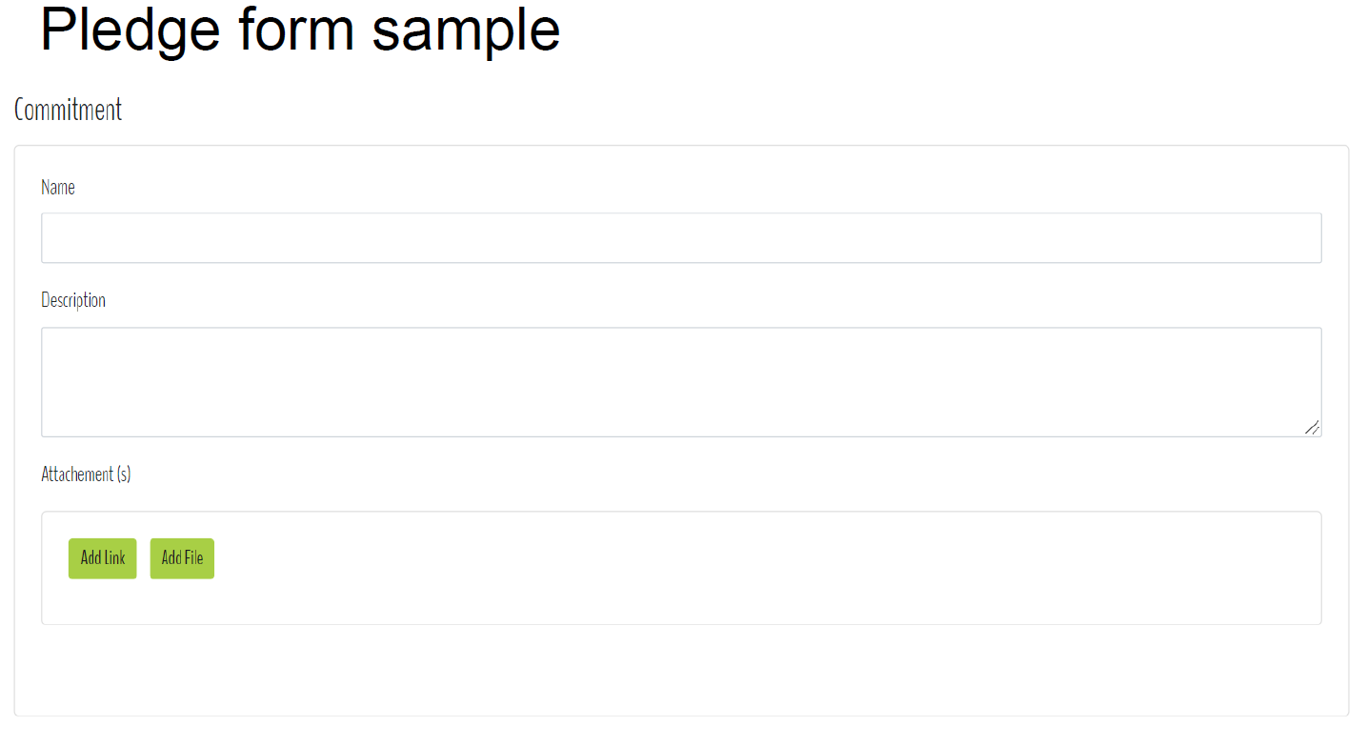
5. Steps to make your voluntary commitment
Impact/Incentive:
How to make a commitment?

Slide 14
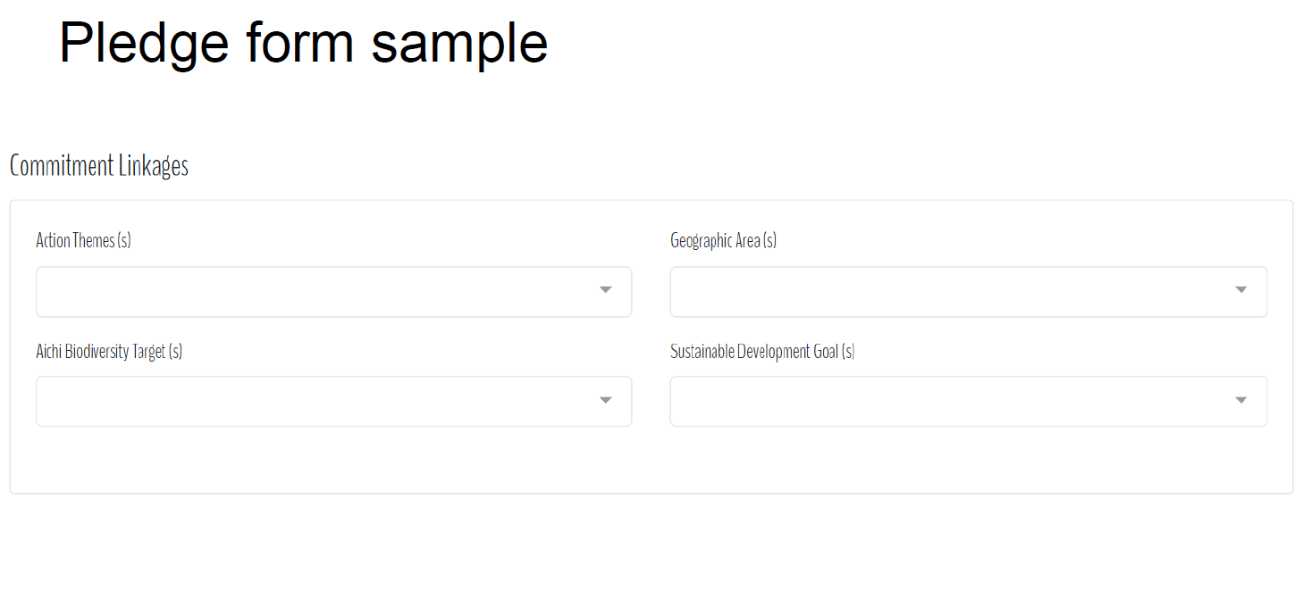
5. Steps to make your voluntary commitment
Impact/Incentive:
How to make a commitment?

Slide 15
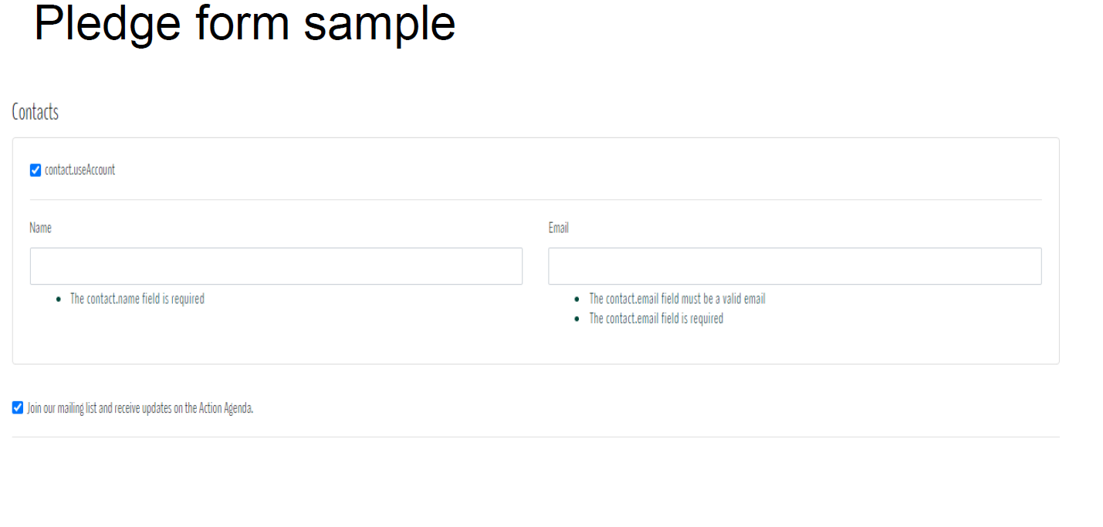
5. Steps to make your voluntary commitment
Impact/Incentive:
How to make a commitment?

Slide 16
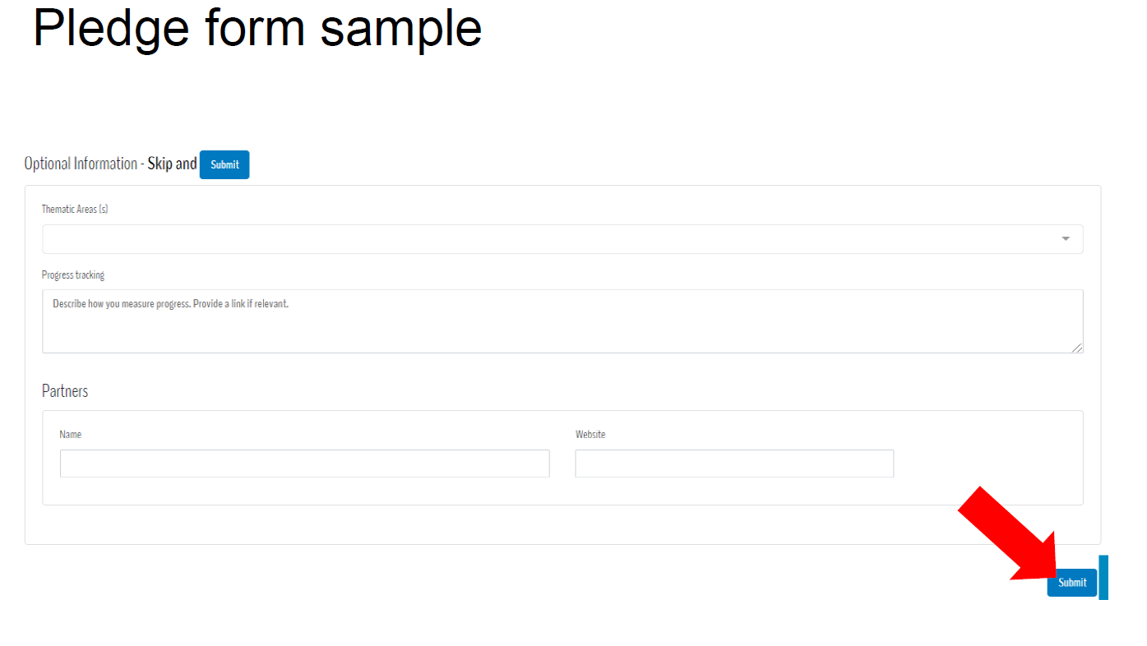
5. Steps to make your voluntary commitment
Impact/Incentive:
How to make a commitment?

